Slide 1
GRADUATE ADMISSION PREDICTION
Akriti Gobhil, Akshay Sutagatti, Lavanya A, Manish Dhruva, Sai Chandrika, Shreya Junjappanavar, Shriya Ellur

Slide 2
01
Problem Statement
02
Dataset and it’s variables
03
Data Analysis
Agenda
04
Data Preprocessing
05
Linear Regression(OLS)
06
Conclusion

Slide 3
Problem Statement
Students are often worried about their chances of admission in graduate school.
The aim of this machine learning model is to help students in shortlisting universities with their profiles.
The predicted output gives them a fair idea about their admission chances in a particular university.
This will assist students to know in advance if they have a chance to get accepted.

Slide 4
Dataset Variables
LOR:
Letter of Recommendation Strength (LOR) which verifies the candidate professional experience, builds credibility, boosts confidence and ensures your competency. The score is out of 5 points (numeric)
TOEFL Score:
Test of English as a Foreigner Language (TOEFL) score, which will be out of 120 points (numeric)
GRE Score:
University Rating:
Graduate Record Exam1 (GRE) score. The score will be out of 340 points (numeric)
University Rating (Uni.Rating) that indicates the Bachelor University ranking among the other universities. The score will be out of 5 (numeric)
SOP:
Statement of purpose (SOP) which is a document written to show the candidate's life, ambitious and the motivations for the chosen degree/ university. The score will be out of 5 points (numeric)
CGPA:
Undergraduate GPA (CGPA) out of 10 (numeric)
Research:
Research Experience that can support the application, such as publishing research papers in conferences, working as research assistant with university professor (either Yes or No) (categorical)
Chance of Admit:
One dependent variable can be predicted which is chance of admission, that is according to the input given will be ranging from 0 to 1 (numeric)

Slide 5
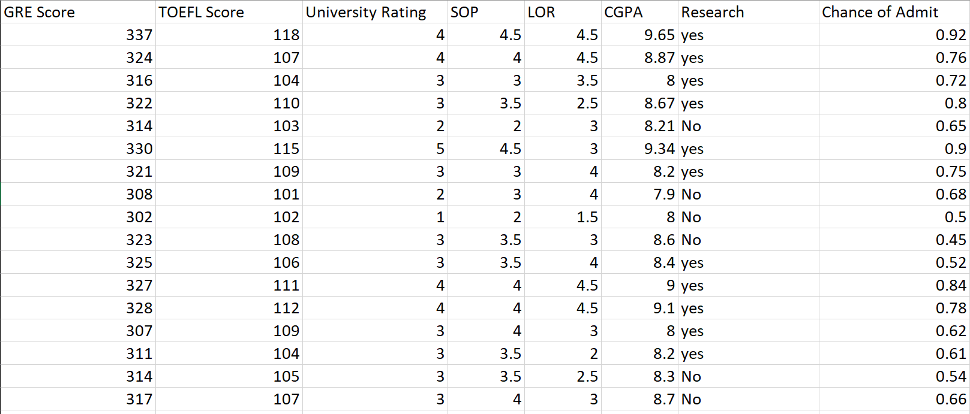
A Glance At The Dataset

Slide 6
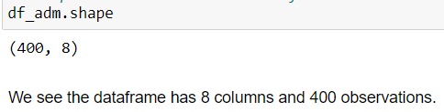
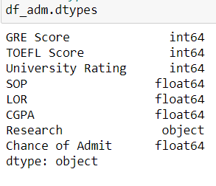
Data Dimension
Data Analysis
Data Types

Slide 7
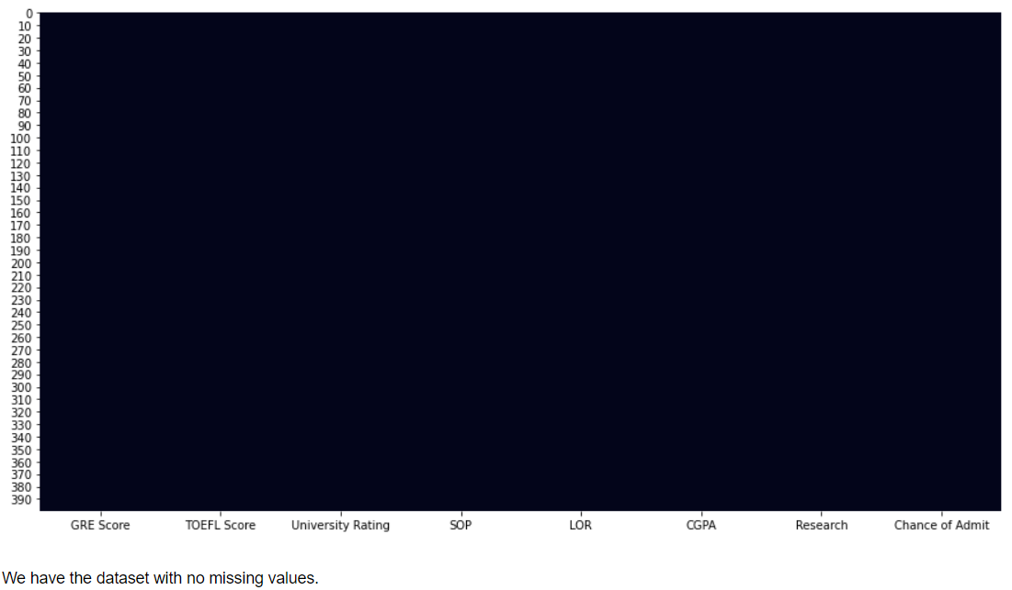
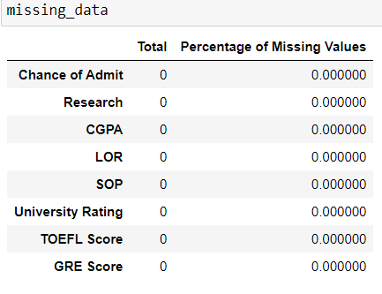
Missing Values
Data Analysis

Slide 8
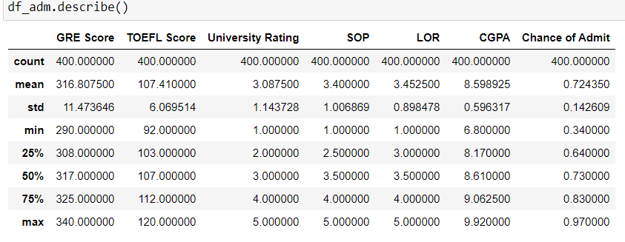
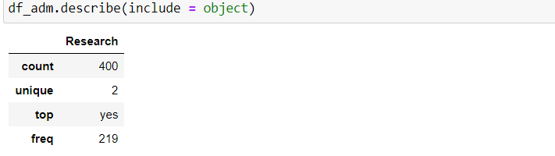

For numerical variables
Summary Statistics
For categorical variables

Slide 9
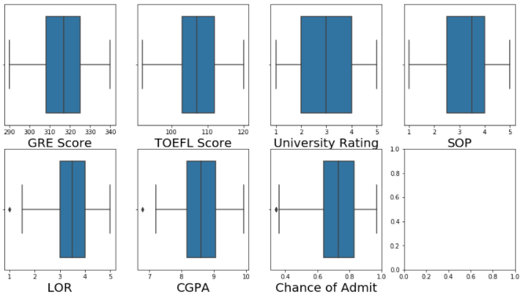


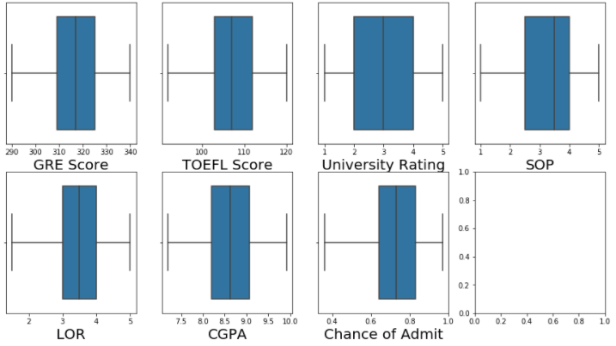
Data Dimension after
removing outliers
Outliers Treatment using IQR method

Slide 10
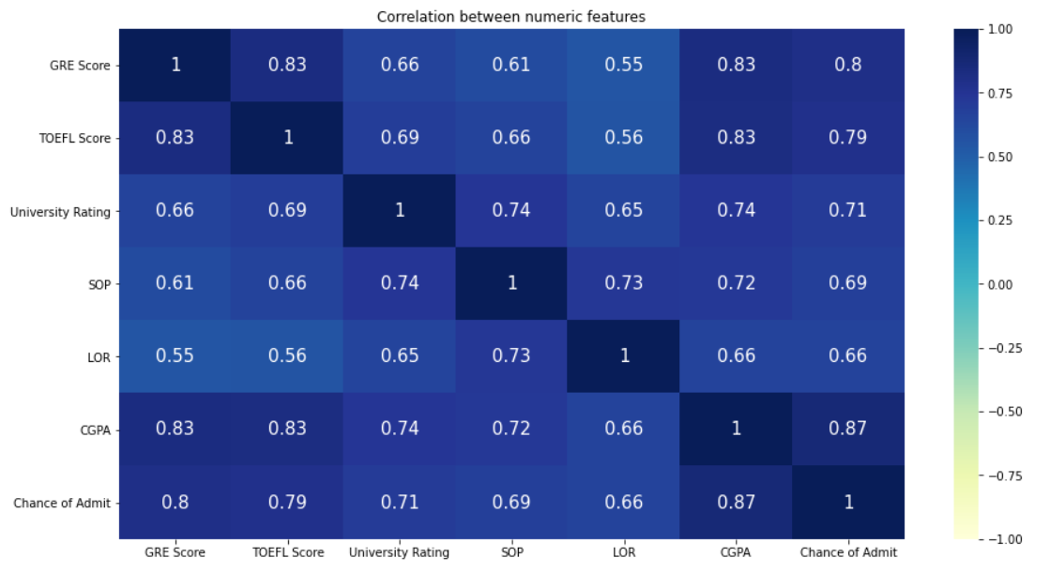
HeatMap Correlation between numeric features

Slide 11
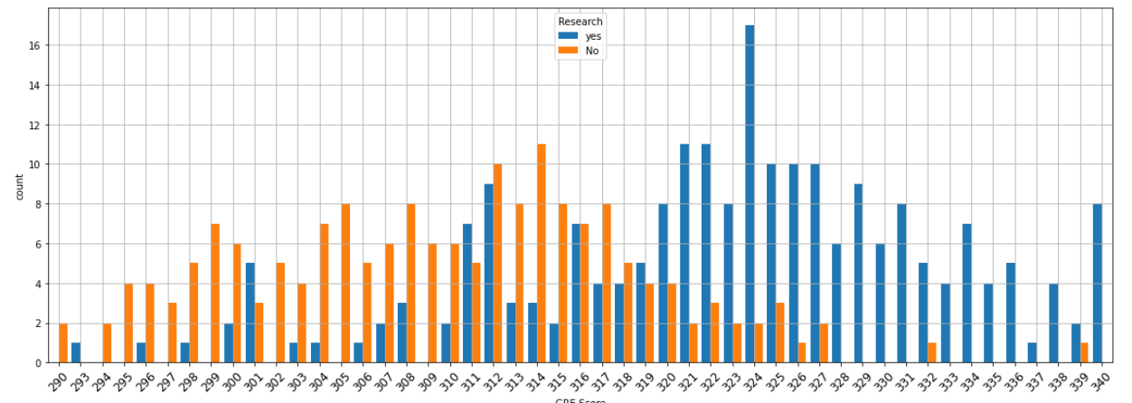
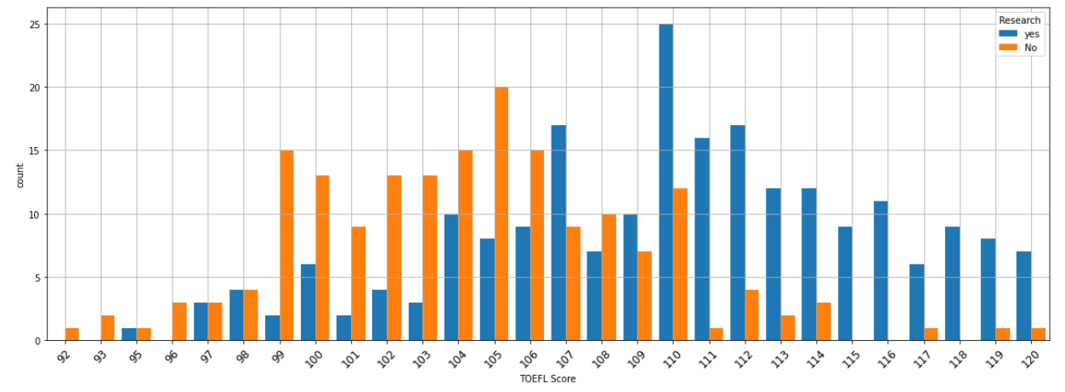
Analysis of relationship between GRE score and
research
Relationship Between Variables
Analysis of relationship between TOEFL score and
research

Slide 12
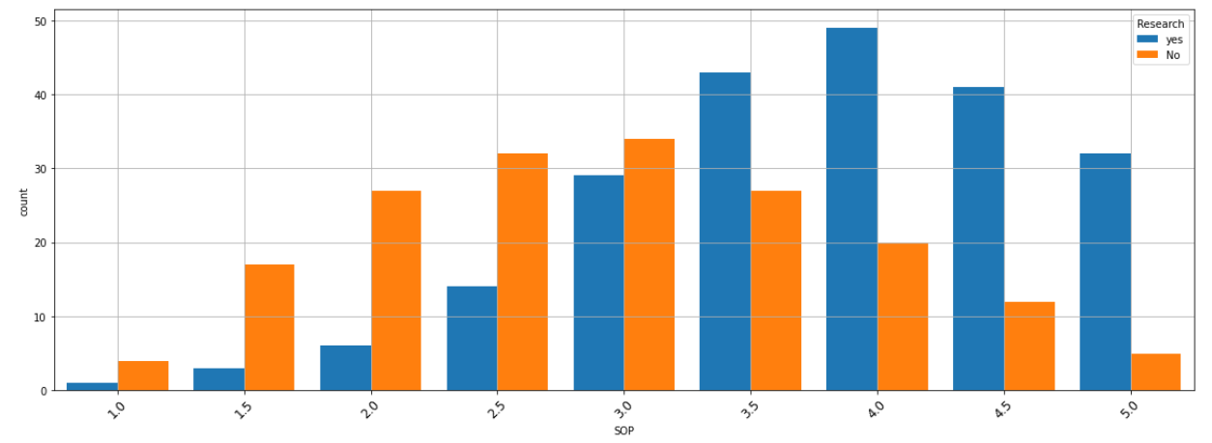
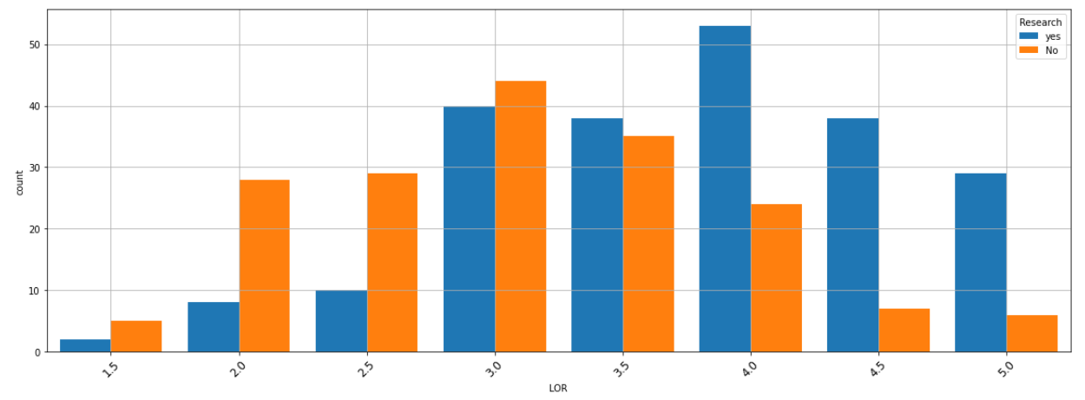
Analysis of SOP score
based on research
Relationship Between Variables
Analysis of LOR score
based on research

Slide 13
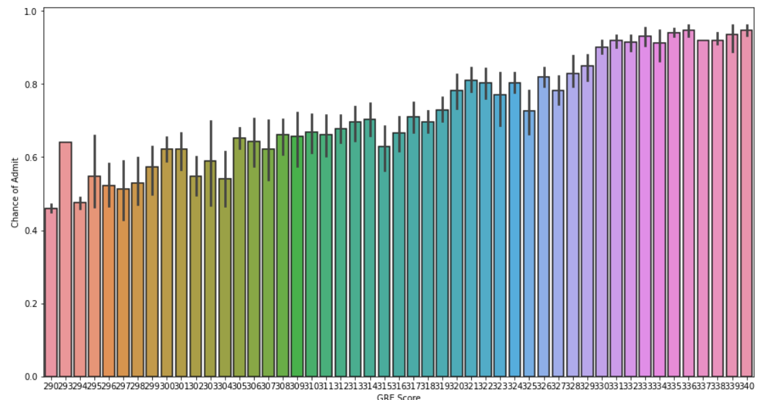
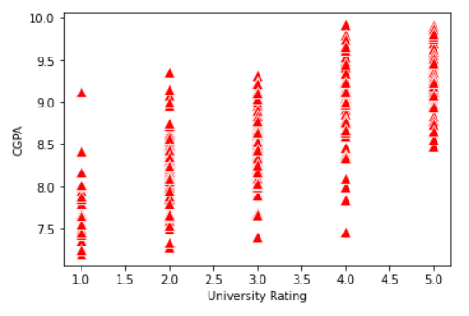
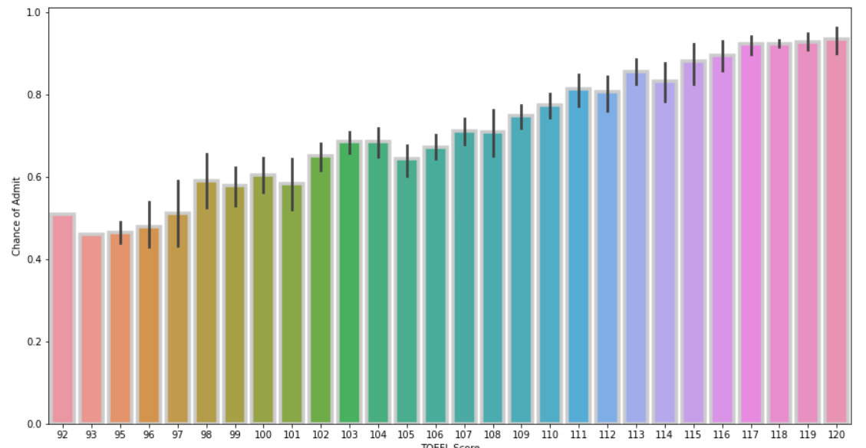
Analysis between GRE score
and Chance of Admit
Analyze the relationship between University Rating and CGPA
Analyze the relationship between TOEFL score and
Chance of Admit

Slide 14
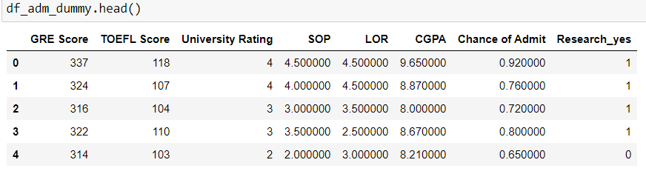
Dummy Encoding for Categorical variables
Since OLS works only on numeric data

Slide 15
Linear Regression
Linear regression is one of the easiest and most popular Machine Learning algorithms. It is a statistical method that is used for predictive analysis. Linear regression makes predictions for continuous/real or numeric variables such as sales, salary, age, product price, etc.
Simple
Linear
Regression
Multiple
Linear
Regression
If a single independent variable is used to predict the value of a numerical dependent variable, then such a Linear Regression algorithm is called Simple Linear Regression.
If more than one independent variable is used to predict the value of a numerical dependent variable, then such a Linear Regression algorithm is called Multiple Linear Regression.

Slide 16
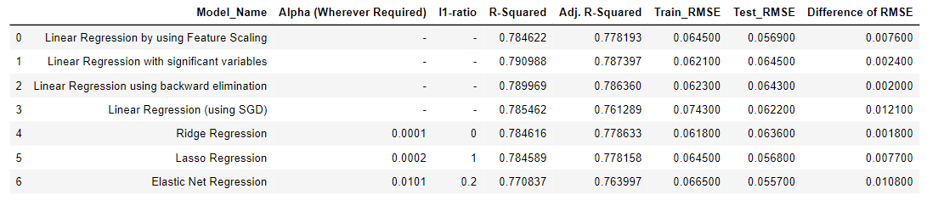
Conclusion

